Slide 1

Computing final project
Data Analysis of different Universities in UK region.
Team Members :
Sai Lokesh Siddanathi
Divya Preksha Reddy Gali
Krishna Chaitanya MVS
Aditya Prakash Addanki
Harshitha Gangasani

Slide 2

Agenda
Objective
Attributes
Data Cleaning and Data Transformation
Data Analysis
Conclusion

Slide 3
Objective
The goal of this project is to find the best university in UK from the list of different universities or colleges in the data set.

Slide 4
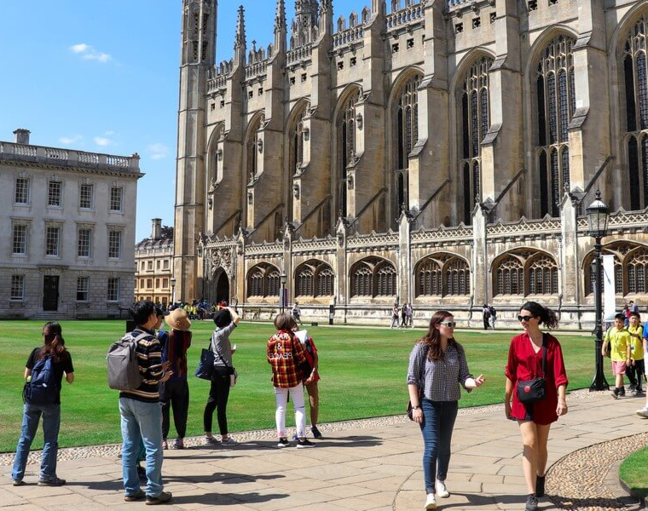
Attributes
University: University Name
Location: University location
Year: Year founded
Tag Line: Main Motto or core value of the university
World Class Rank: World Ranking of the university
UK Rank: UK rank of the university
CWUR: Centre for world university rankings score
Min IELTS Score: Minimum IELTS requirement score
Avg. UG Tuition fees: UG Tuition fees in pounds

Slide 5
11. International student percent: Percentage of International students
studying in the university.
12. Enrolled students: Count enrolled students at university
13. Teaching staff: Count no. of staff members
14. Living Expenses: Cost of the living (Approx.) at university per year
(in pounds)
15. Campus Locality: Location of the campus (Rural/Urban/Suburban)
16. Latitude: Location Latitude
17. Longitude: Longitude Location
18. Website: University Website
19. Type: Control type of university
20. Calendar: Academic calendar of the university.
21. Student Satisfaction Percentage: Percentage of students who are satisfied

Slide 6

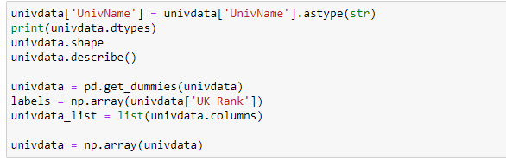
Data Exploration, Data Cleaning and Data Transformation

Slide 7


Slide 8
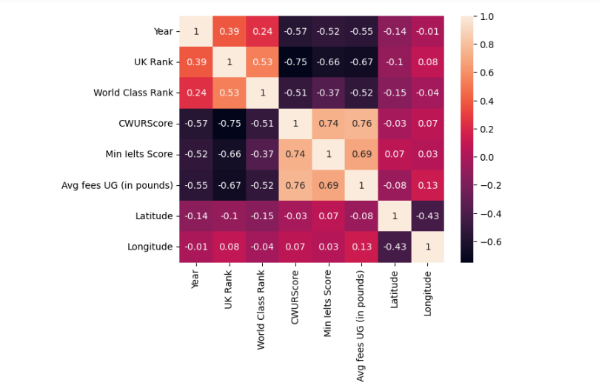
Correlation Matrix- heatmap
.
Year, UK Rand and World class has strong relation.

Slide 9
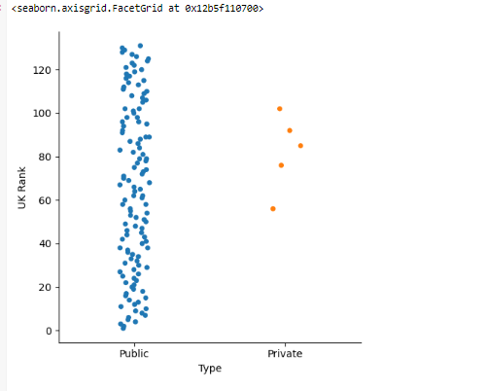
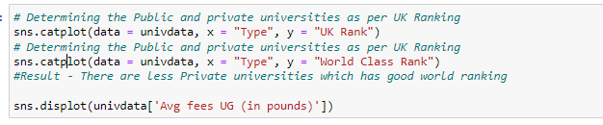
Scatter PLOTS
UK Rank with Public vs Private:
.

Slide 10
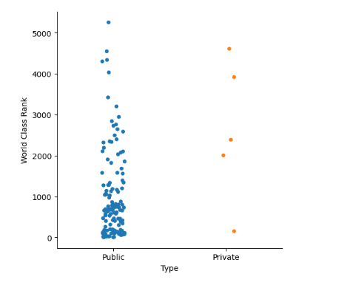
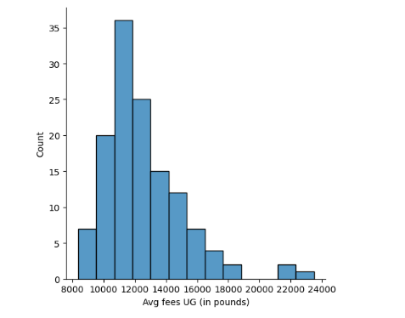
World Class Rank with Public vs Private
Histogram of Count of Colleges vs Fees
.

Slide 11
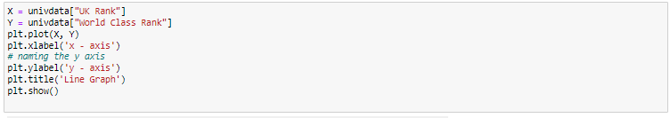
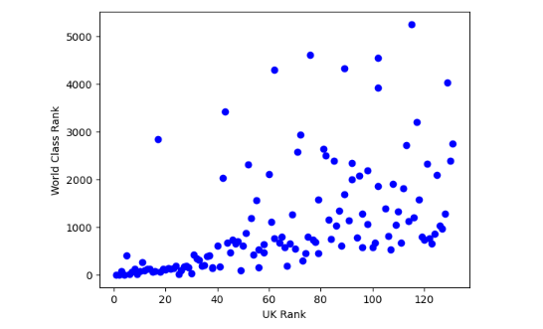
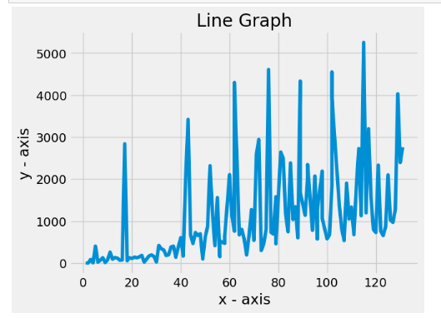
UK Rank and World Class Rank
.

Slide 12
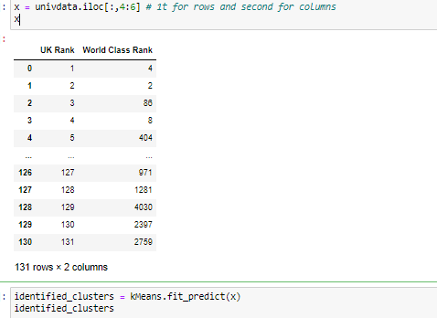
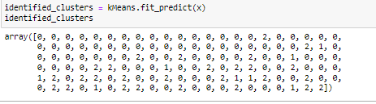
K-MEAN MODEL
.
K-Mean Cluster and Array

Slide 13
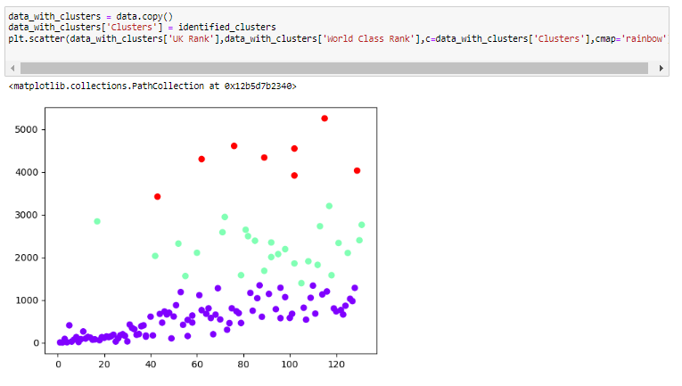
Clustered Data from Predictions
.

Slide 14
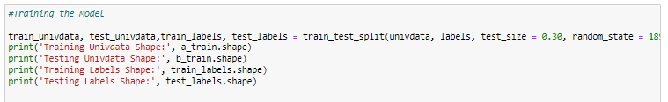
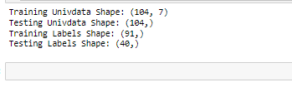
Training and Testing Data – Split and Validation
.
Random seed is defined as 1899 and test data is 30% and training data is 70%.
Results of Test and Train Model:

Slide 15

Results
University of Leicester, Keele University and Sheffield Hallam University are the best colleges that are predicted from the given dataset.

Slide 16




Thank you

